Slide 1
The Print Project
Division of Information Technology December 1, 2016

Slide 2
Challenges:
Notes:
Do you have one of these in your office? Chances are you do because there are well over 3000 printers on campus, to say nothing of the fax machines, scanners, and copiers we have.
I’m sure that everyone has heard something about the print project so today I’d like to use this presentation and this time as a way of sharing why we are motivated to do a print project, to put some facts on the table, debunk a few myths, and generally try to answer any questions you may have.

Slide 3
Printing at NIU
Notes:
We print a lot: 24M pages per year at last count. That volume of printing is enough to kill 3000 trees, or 55 acres worth based on some statistics I found that show the average density of trees in Illinois.
That’s a lot of printing…

Slide 4
Printing at NIU
Notes:
… and we do it on a lot of printers.
Over 3300 printers in our first study. That’s nearly one per FTE. I’ve been in plenty of offices where a person will have one BW and one color printer. I’m sure you also know offices where that setup might also include a scanner. Maybe even a fax machine.
And along with those printers come boxes and cabinets and closets of toner. One of our first inventories, a sample of nine buildings done in 2014, shows that when a printer dies it is often replaced with a new model of printer, often from a different manufacturer. The result is that there are dozens of different types of toner and ink cartridges in those nine buildings that were just abandoned in place, wasted because we weren’t buying strategically.

Slide 5
The most expensive way to print
Notes:
It probably won’t surprise you to know that we do most of our printing on the most expensive type of printer there is: a personal desktop printer, of either the personal laser or inkjet variety.
I’m sure you all have heard of and maybe even ”bought” for yourself an inkjet printer that was free after rebate. Of course we all know that Canon, Dell, and Epson aren’t fools. They know they’ll make that money back on the ink cartridges.
Ink like that shown in the picture above costs $13 - $75 per ounce. That’s several thousand dollars per gallon! Now to be fair, these printers are marvels of modern technology, able to spray little dots of ink onto the paper whose volume can sometimes be measured in picoliters. When you balance the insanely expensive ink with the amazingly small drops, it’s not clear how those are going to balance but again I direct you to the fact that some printers are free because these companies make their money on the ink. With rare exceptions, a personal printer is a very expensive way to print.

Slide 6
What if …
Imagine a way to print
Cheaper
Faster
Higher quality
Securely
From anywhere
To anywhere
Notes:
Well as I looked around our campus a few years ago, as part of getting to know my new university, I couldn’t help noticing all the printers. Now I happen to know that nobody in my job wants to do a project to save money by implementing shared printers. People get personal about printers. More than any other part of technology, people seem to develop a personal attachment to the printer on their desk. Maybe it’s because you touch a printer every day so it seems more real.
But anyway, nobody wants to do a print project because good people can sometimes leave the rational place and get very intense about wanting to keep the printer on their desk.
Still, much is known about printing because worldwide it’s nearly a $1 trillion industry and that just counts commercial printing. We know that there are ways to do it better, faster, cheaper so consider the benefits in the slide above. What if we could have all those? …

Slide 7
What if …
I also throw in
Free scanning
Free paper
Free faxing (if you really must use faxes)
Free network connection
Notes:
And all these benefits too?
Would that be enough to entice people away from their personal printers and make them willing to walk ten steps to go get a job off a shared printer?

Slide 8
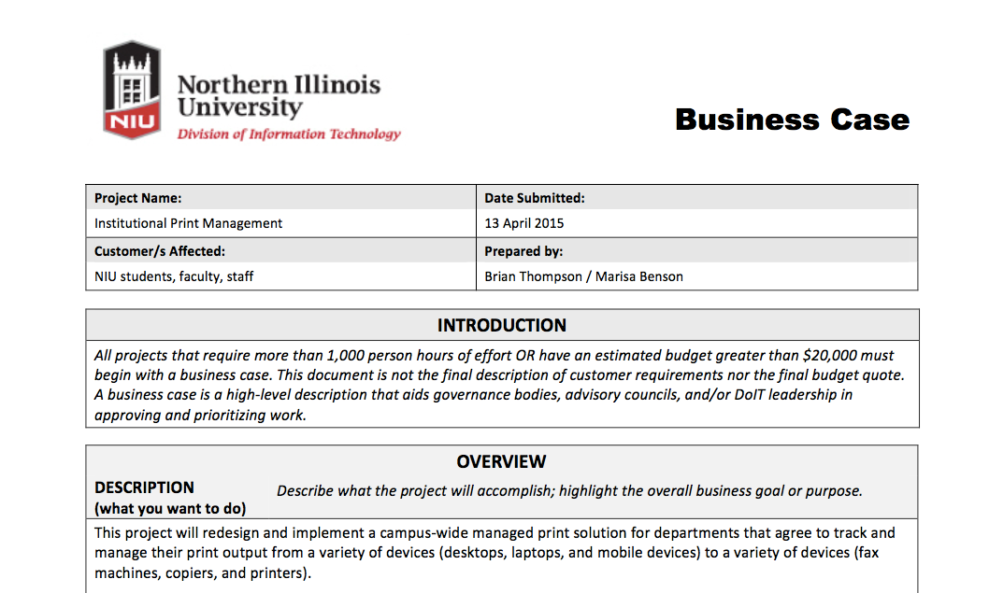
The Print Project
Notes:
I think it is persuasive for most people and as a result, back in 2015 we put together a business case and ran that through the IT governance process.
The basic intent of that business case was to visit each office, inventory their printers, explain the benefits (faster, better quality, cheaper, secure…), give them time to mull it over, ask them if they want to swap any of their personal printers, deliver new shared printers if so desired, and then move on to the next office.
We did this with my whole division, the President’s Office, the Provost’s Office, VP Weldy’s Office, the Office of General Counsel, Purchasing, and maybe another office or two. After running through those areas, our estimate was that it would take two years to finish the project at the rate we were going. So, we settled in and figured we’d be doing this for a while. What we didn’t count on was the crash.

Slide 9
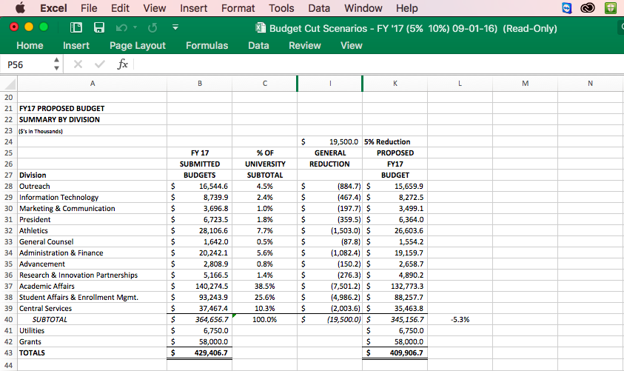
The Crash
Notes:
By “the crash” I really mean the 5% cost cutting exercise we’ve been through over the summer. Because the State has shortchanged us on our budget allocation and we’ve fallen short on enrolled students, NIU is short on money. The spreadsheet shown here is the actual copy of my expense challenge. DoIT is on line 29 and as you can see from column I, I need to give back $467,000 dollars. My business office is doing the journal entry for that this week as a matter of fact. In fact we’re giving back more than $467k.
This is something that all the vice presidents worked on through the summer and into about September.

Slide 10
The Change
University is short on money
Cost cutting didn’t reach the goal
How can we save more?
Printer reduction saves $500,000 per year
Notes:
But the bottom line is that our cost cutting didn’t reach its goal. By which I mean that the sum of all the VP cuts did not equal the target for reductions.
To try to save more, DoIT put an idea on the table.
According to the best good faith estimates, if we move half of the print volume from individual printers over to shared printers we should save half a million dollars per year. What if we could get that migration done this fiscal year instead of two years from now? That wouldn’t really help us in FY17, but we’d be set and saving on day 1 in FY18.
Lots of groups looked at this and while there are some reservations, it’s better to cut printers than to go deeper into budget cuts on many of the areas that didn’t reach their 5% targets.
Who looked at it? IT directors from local IT groups, IT Steering Committee, Executive Budget Committee, Operating Cabinet, and Senior Cabinet. The project team is still scrambling to deal with the request to turn a two year project into a two month effort that mostly begins in earnest in January. It took all of October and part of November to work out logistical details, negotiate with our vendor to massively accelerate the project, create a schedule, address technical issues that we thought we wouldn’t face for over a year, work with the OneCard office and more. But in mid-November we finally put together a project plan that suggestd it could be done. Then we turned our attention to communications, which I freely admit we should have started earlier.

Slide 11
About printing
Exceptions
Private and Secure
Cheaper
Scan and fax for free
Print from home
Print at another building
Print from your phone
Notes:
Let’s talk about things we know are true:
Exceptions will be given and now we know the exception policy, as of December 2. VP’s and Deans. Some common and sensible exceptions that I could easily imagine VPs granting are: documented physical disability, grant funded printers, building too small to warrant a shared printer, keeping a single emergency backup printer for a floor or building, etc.
Privacy and Security are assured for nearly all situations.
It really is cheaper to print this way, though the topic of what it costs to print a page is a surprisingly difficult subject that I just can’t get into in the time we have.
Scanning and faxing will not incur extra charges.

Slide 12
About printing
Stealing personal printer
Denying repairs
Walk to another building
Reimburse for your recently purchased printer
Taking grant-funded printers
Notes:
I’ve heard some things that I just need to debunk for you:
Some people have suggested that they would like to bring in their personal printer from home. They’d like to know if I am going to take it away and the answer is no. I can’t and won’t take your personal printer away from you. But I also don’t think NIU should be buying ink for your personal printer, even if you swear you’re only going to do NIU business with that ink.
I am not, and have never suggested that I would, denying funding or authorization for printer repairs. I don’t know where that comes from.
I will not make you walk to another building. See previous discussion about exceptions. If you have a small building that doesn’t warrant a shared printer, that sounds like a good reason to have an exception.
There is a series of good and fair questions about assets that still have a lot of life left in them. Printers, paper, toner, ink, etc. There is no plan right now to reimburse for a recently purchased printer, though to some extent I can see brand new devices being a valid reason for an exception. That’s a local decision, not something central IT should be deciding.

Slide 13
About printing
DoIT pays for paper
Use printer until dies
Student employees
Why we lock paper trays
Printers in public spaces
Notes:
The question about whether the cost of printing should include the paper was made difficult by varying preferences between departments. That was decided at the IT Steering Committee today and DoIT will be including the cost of paper. We’re able to include that now and still keep the costs below the current recharge rate for a number of reasons, mostly the volume discount we get when we move half of our printing over. DoIT will also deliver the paper but you’ll have to load it yourself, just as you do when your personal printer is out.
There’s much to say about using up assets. There’s an FAQ that describes some of the conversation the VP’s have had about this topic. Refer to that.
Student employee printing (and by extension, printing for people with dual appointments) is an area where we again have widely varying opinions between different departments on campus. The one thing I do know is that the software doesn’t allow us to satisfy both camps at the same time. I don’t have finality yet, but we should have a final decision on how student employee printing will work before the Break.
Locking paper trays is weird to start with, as nobody working on the print project including our vendor, knows of another school that has our degree of concern with theft of paper out of printers. Same for vandalism of printers in public spaces. I’d welcome anyone with stats instead of anecdotes. Is this really a problem? I need to know because locked paper trays would mean that DoIT would be the only group on campus that can change paper in your departmental printer and that just doesn’t seem right.

Slide 14
The Print Project

Slide 15
What Comes Next
My Next Steps
Letter from President
Exception Policy
Schedule
Tech-y things
Housing and Dining
More communications
Gather feedback!
Your Next Steps
Share what you heard
Think critically
Communicate problems
Work with local IT
Spot good exceptions
Consider paperless!

Slide 16
Point of Contact
Questions and Concerns
Project Manager: Lisa Arnold (larnold@niu.edu)

